Slide 1

Event Management System - Final Project
Prepared by Vandana Yalamanchi

Slide 2
Project Overview
Event Management System for digital event operations
Features: Registration, ticketing, payments, scheduling
Tools: GitHub, Basecamp, PowerPoint

Slide 3
Objectives
Automate event planning
Improve attendee experience
Provide a unified dashboard for organizers

Slide 4
Updated Project Charter
Added change-tracking section
Adjusted timeline for Ontario holiday
Updated scope and risks
Expanded deliverables

Slide 5

Project scope
Within Scope
Event creation and scheduling
Online registration and ticketing
Payment gateway integration (CAD)
Automated reminders and notifications
Advertising and sponsor management
Venue maps and session scheduling
Attendee networking features

Slide 6

Outside of Scope
Physical event logistics such as catering or equipment rental
Offline ticket sales or cash payments
On-site hardware management
Post-event physical surveys

Slide 7
Roadmap Summary
Week 1–2: Requirements & Charter
Week 3–4: UI/UX Design
Week 5–8: Development
Week 9–10: Enhancements
Week 11–12: Testing
Week 13: Submission & Presentation

Slide 8
Basecamp Plan
Created To-Do lists
Added schedule with milestones
Uploaded Docs & Files
Identified critical path

Slide 9
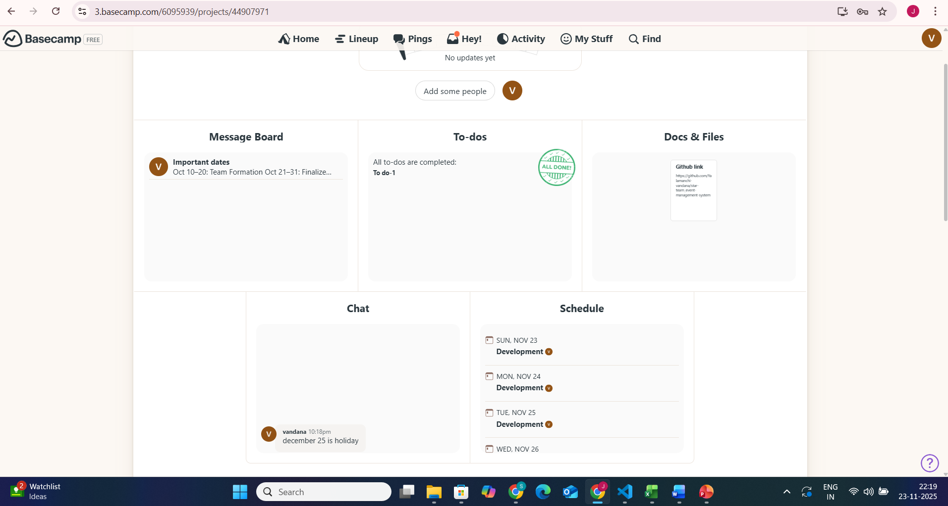
Basecamp Dashboard Screenshot

Slide 10
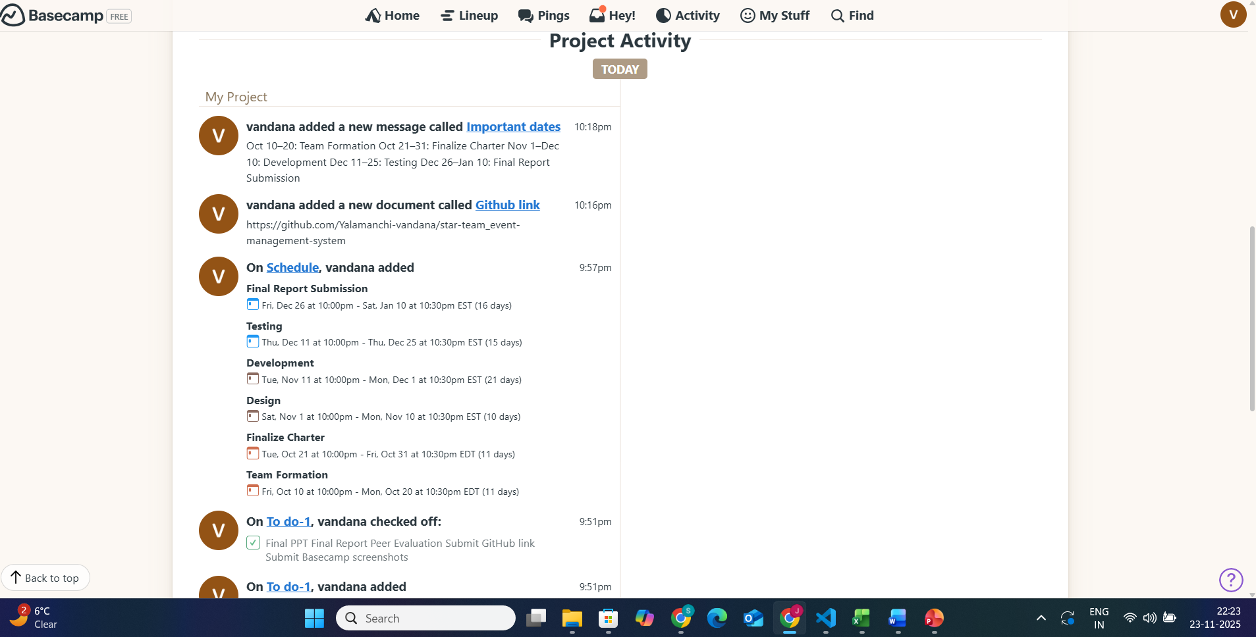
Basecamp Schedule Screenshot

Slide 11
GitHub Repository Overview
Repo: star-team-event-management-system
Public repository
README explains setup & purpose
Commit history included

Slide 12
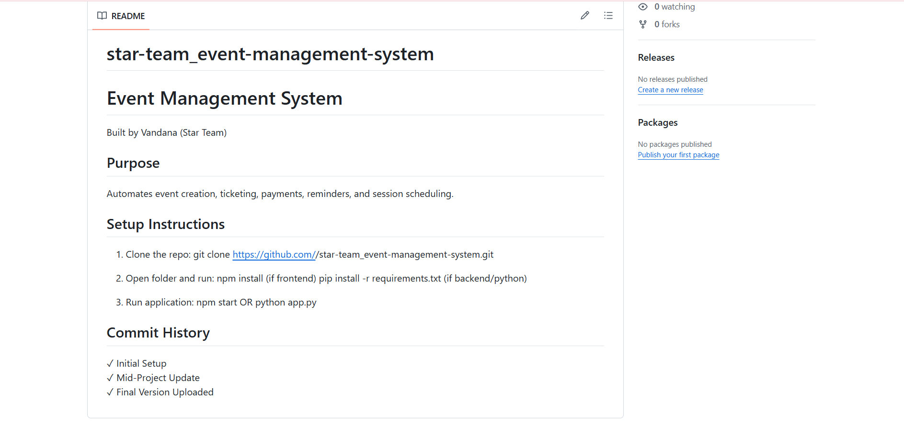
GitHub README & Repo Screenshot

Slide 13
Challenges & Risks
Solo project workload
API integration issues
Timeline constraints

Slide 14
Project Results
Completed roadmap, Basecamp, and GitHub
Final report and PPT prepared
All components aligned with requirements

Slide 15
Conclusion
Successfully delivered full project
Demonstrated planning, execution, documentation
Ready for submission

Slide 16
Thank you

